Slide 1
Analytic Geometry

Slide 2
SPECIFIC OBJECTIVES:
At the end of the lesson, the student is expected to be able to:
•Familiarize with the use of Cartesian Coordinate System.
•Determine the distance between two points.
•Define and determine the angle of inclinations and slopes of a single line, parallel lines, perpendicular lines and intersecting lines.
•Determine the coordinates of a point of division of a line segment.
•Define the median of the triangle and find the intersection point of the medians of the triangle.

Slide 3
FUNDAMENTAL CONCEPTS
DEFINITIONS
Analytic Geometry – is the branch of mathematics, which deals with the properties, behaviors, and solution of points, lines, curves, angles, surfaces and solids by means of algebraic methods in relation to a coordinate system.

Slide 4
Two Parts of Analytic Geometry
1. Plane Analytic Geometry – deals with figures on a plane surface
2. Solid Analytic Geometry – deals with solid figures

Slide 5
Directed Line – a line in which one direction is chosen as positive and the opposite direction as negative.
Directed Line Segment – consisting of any two points and the part between them.
Directed Distance – the distance between two points either positive or negative depending upon the direction of the line.

Slide 6
RECTANGULAR COORDINATES
A pair of number (x, y) in which x is the first and y being the second number is called an ordered pair.
A vertical line and a horizontal line meeting at an origin, O, are drawn which determines the coordinate axes.

Slide 7
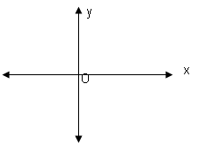
Coordinate Plane – is a plane determined by the coordinate axes.

Slide 8
X – axis – is usually drawn horizontally and is called as the horizontal axis.
Y – axis – is drawn vertically and is called as the vertical axis.
O – the origin
Coordinate – a number corresponds to a point in the axis, which is defined in terms of the perpendicular distance from the axes to the point.

Slide 9
DISTANCE BETWEEN TWO POINTS
1. Horizontal
The length of a horizontal line segment is the abscissa (x coordinate) of the point on the right minus the abscissa (x coordinate) of the point on the left.

Slide 10
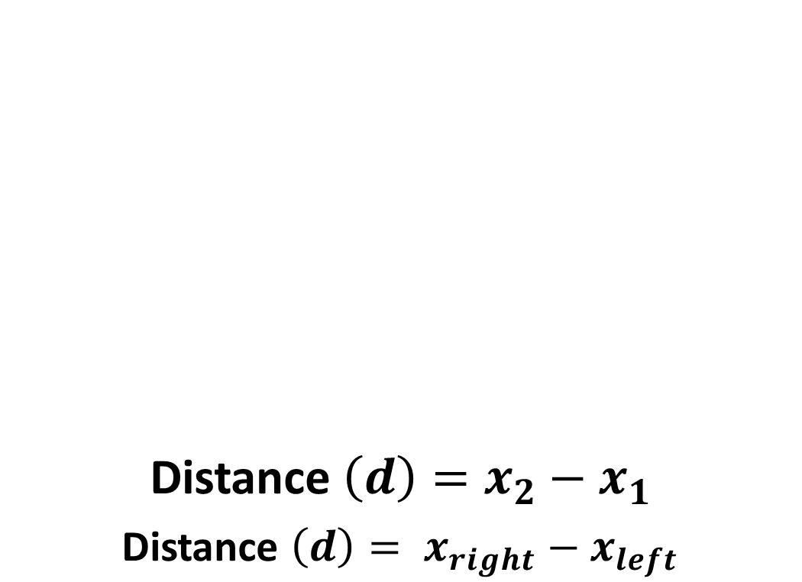
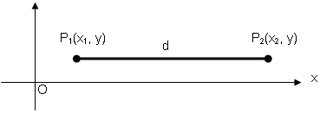

Slide 11
2. Vertical
The length of a vertical line segment is the ordinate (y coordinate) of the upper point minus the ordinate (y coordinate) of the lower point.

Slide 12
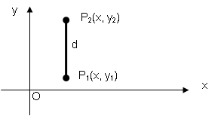
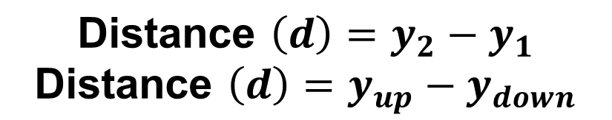

Slide 13
3. Slant
To determine the distance between two points of a slant line segment add the square of the difference of the abscissa to the square of the difference of the ordinates and take the positive square root of the sum.

Slide 14
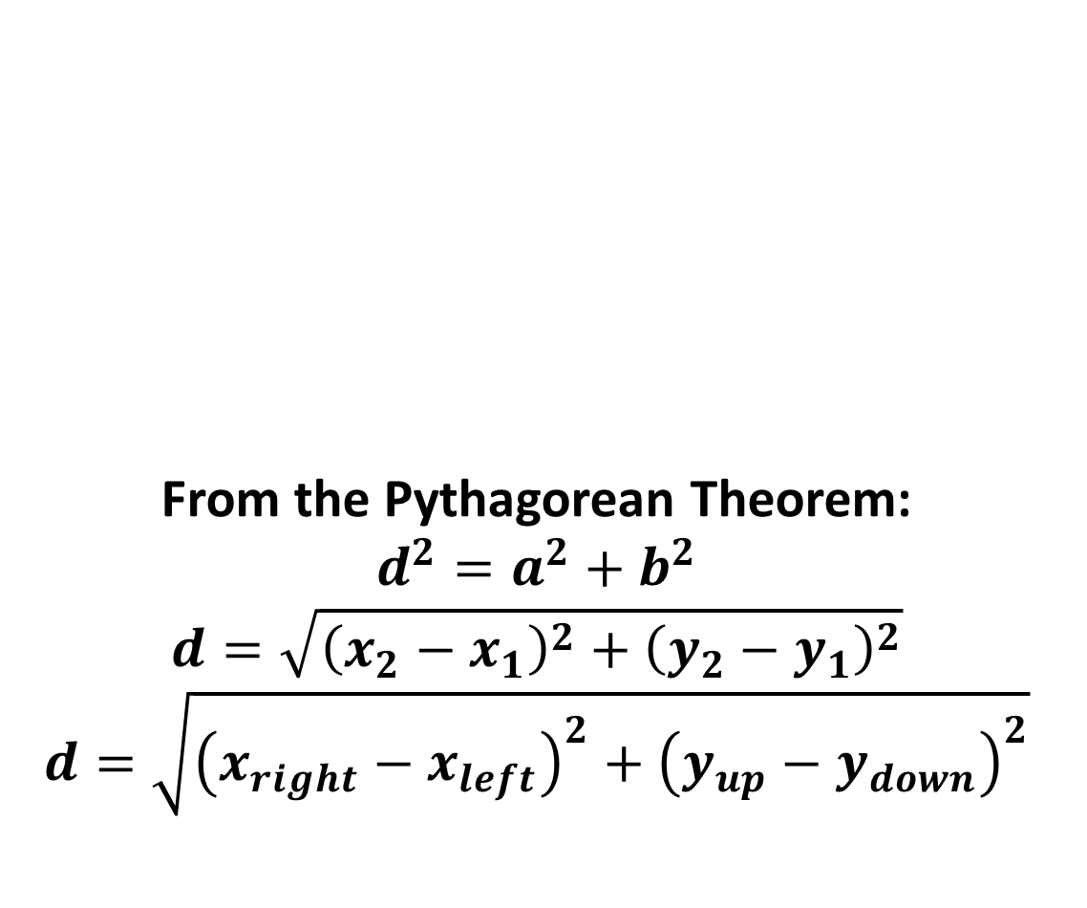
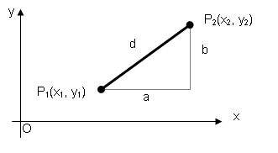

Slide 15
SAMPLE PROBLEMS
4. Show that the triangle A (1, 4), B (10, 6) and C (2, 2) is a right triangle.
5. The vertices of the base of an isosceles triangle are (1, 2) and (4, -1). Find the ordinate of the third vertex if its abscissa is 6.
Find the radius of a circle with center at (4, 1), if a chord of length 4 is bisected at (7, 4).

Slide 16
Find the distance between the points (4, -2) and (6, 5).
By addition of line segments show whether the points A(-3, 0), B(-1, -1) and C(5, -4) lie on a straight line.
The vertices of the base of an isosceles triangle are (1, 2) and (4, -1). Find the ordinate of the third vertex if its abscissa is 6.
Find the radius of a circle with center at (4, 1), if a chord of length 4 is bisected at (7, 4).
Show that the points A(-2, 6), B(5, 3), C(-1, -11) and D(-8, -8) are the vertices of a rectangle.
Find the point on the y-axis that is equidistant from (6, 1) and (-2, -3).

Slide 17
SAMPLE PROBLEMS
1. Determine the distance between
a. (-2, 3) and (5, 1)
b. (6, -1) and (-4, -3)
2. Show that points A (3, 8), B (-11, 3) and C (-8, -2) are vertices of an isosceles triangle.
Show that the triangle A (1, 4), B (10, 6) and C (2, 2) is a right triangle.
Find the point on the y-axis which is equidistant from A(-5, -2) and B(3,2).

Slide 18
Find the distance between the points (4, -2) and (6, 5).
By addition of line segments show whether the points A(-3, 0), B(-1, -1) and C(5, -4) lie on a straight line.
The vertices of the base of an isosceles triangle are (1, 2) and (4, -1). Find the ordinate of the third vertex if its abscissa is 6.
Find the radius of a circle with center at (4, 1), if a chord of length 4 is bisected at (7, 4).
Show that the points A(-2, 6), B(5, 3), C(-1, -11) and D(-8, -8) are the vertices of a rectangle.
Find the point on the y-axis that is equidistant from (6, 1) and (-2, -3).

